Slide 1
Stepping Stone to Advanced JavaScript
22nd Dec 2015
D G ANNOJIRAO

Slide 2
Coming Up
Objects & Arrays
In and out of prototypes
Prototypal Inheritance
Constructors in JavaScript
OO concepts in JavaScript
Few tips and tricks

Slide 3
Objects in JavaScript
var obj = new Object();
var obj = {}
var person = {firstName:"John", lastName:"Doe", age:50, eyeColor:"blue"};
Object.keys(person) returns ["firstName", "lastName", "age", "eyeColor"]
var person = {
name: "manas",
sayName: function() {
console.log(this.name);
}
};
console.log("name" in person); // true
console.log(person1.hasOwnProperty("name")); // true

Slide 4
Objects -- Continued
Removing the properties from the objects
delete person.name;
Adding new property
person.lang= “kannada”;
or
person[“lang”] = “kannada”;
Notes:
var person = {firstName:"John", lastName:"Doe", age:50, eyeColor:"blue"};
delete person.age
After deletion
Console.log(person)
var person = {firstName:"John", lastName:"Doe", eyeColor:"blue"};

Slide 5
Objects -- Continued
Preventing Object Modification
1 .Preventing Extensions
var person= {name:”annojirao”};
console.log(Object.preventExtensions(person))
Object.preventExtensions(person);
console.log(Object.isExtensible(person));
person.age = 50;
preventExtensions prevents adding new properties or methods to object but allows editing of existing properties and methods or deletion of properties and methods
console.log(person)
Notes:
var person= {name:"annojirao"};
console.log(Object.preventExtensions(person))
Object.preventExtensions(person);
console.log(Object.isExtensible(person));
person.age = 50; console.log(person)

Slide 6
Objects -- Continued
2. Sealing Objects
If an object is sealed, one can only read from and write to its
properties.
var person= {name:"annojirao"};
Object.isSealed (person); // false
Object.seal(person);
person.name = “annojiraodg”
delete person.name
console.log(person);
Object {name: "annojiraodg"}
seal prevents the objects getting changed by preventing adding/deleting new/old properties and methods
Notes:
var person= {name:"annojirao"};
Object.seal(person);
console.log(Object.isSealed(person)); // true
console.log(Object.isExtensible(person)) // false;
person.name = "annojiraodg"console.log(person); // Object {name: "annojiraodg"}

Slide 7
Objects -- Continued
3. Freezing Objects
var person= {name:"annojirao"};
Object.freeze(person);
person.name = “kk”;
console.log(person); // Object {name: " annojirao "}
delete person.name // false
console.log(person); // Object {name: " annojirao "}
person.add = “adding”;
console.log(person); // Object {name: " annojirao "}
Freeze prevents addition/deletion of old/new properties or methods i.e when objects are sealed only read operation can be performed on the object
Notes:
console.log(Object.isExtensible(person)); // true
console.log(Object.isSealed(person)); // false
console.log(Object.isFrozen(person)); // false
Object.freeze(person);
console.log(Object.isExtensible(person)); // false
console.log(Object.isSealed(person)); // true
console.log(Object.isFrozen(person));

Slide 8
Objects -- Summary
Object | Edit | Add | Delete
preventExtensions | Yes | No | Yes
Sealing | Yes | No | No
freeze | No | No | No

Slide 9
Arrays
Can store non homogeneous data
Ex: var arr = [1,2,2.3,”hello”,[1,2,3,4],{name:”java”}];
Properties of an Array
Array.prototype
Array.prototype.length
Methods of an Array
Array.isArray()
Array.prototype.forEach()

Slide 10
Array -- Continued
Array.prototype.push()
Array.prototype.reverse()
Array.prototype.shift()
Array.prototype.sort()
Array.prototype.splice()
Array.prototype.unshift()
Array.prototype.concat()
Array.prototype.join()
Array.prototype.slice()
Array.prototype.toString()
Array.prototype.indexOf()
Array.prototype.lastIndexOf()

Slide 11
Inheritance
Inheritance is object-oriented code reuse.
Two Types of inheritance
Classical
Prototypal

Slide 12
Classical Inheritance
Objects are instances of Classes.
A Class inherits from another Class.
Notes:
//Classical inheritance example
class Calculation{
int z;
public void addition(int x, int y){
z = x+y;
System.out.println("The sum of the given numbers:"+z);
}
public void Substraction(int x,int y){
z = x-y;
System.out.println("The difference between the given numbers:"+z);
}
}
public class My_Calculation extends Calculation{
public void multiplication(int x, int y){
z = x*y;
System.out.println("The product of the given numbers:"+z);
}
public static void main(String args[]){
int a = 20, b = 10;
My_Calculation demo = new My_Calculation();
demo.addition(a, b);
demo.Substraction(a, b);
demo.multiplication(a, b);
}
}

Slide 13
Pseudoclassical
Inheritance in JavaScript using function is Pseudoclassical
A prototypal inheritance language should have an operator like the object() which makes a new object using an existing object as its prototype – Object.create in case of Javascript.
JavaScript instead uses operators that look classical, but behave prototypal (Pseudo-classical)

Slide 14
Prototypal – continued
Steps need to be aware of:
constructor functions
The new operator
The prototype member of functions

Slide 15
constructor and new operator
function Parent() {
this.member = initializer;
return this; // optional
}
Parent.prototype.firstMethod = function () {console.log(‘your first method’)};
Parent.prototype.secondMethod = function () {console.log(‘your second method’)};
var newobject = new Parent();

Slide 16
Constructor -- continued
Auto created constructor
function Parent() {
………
}
{constructor: Parent}
prototype
var newobject = new Parent();
newobject.__proto__ = {constructor: Parent}
Calling newobject.constructor actually returns newobject.__proto__.constructor

Slide 17
new Operator -- continued
var newobject = new Parent();
New Object got created
object: {}
Sets constructor property to object instance
newObject.constructor = Constructor;
All properties and methods are delegated to new object
Returns this to the created object

Slide 18
Constructor and new operator -- continued
When functions are designed to be used with new, they are called constructors
new Parent() returns a new object with a link to Constructor.prototype
The new operator is required when calling a Parent function
If new is omitted, the global object is called by the constructor, and then the global object is returned instead of a new instance
var newObject = new Parent();
newObject
parent.prototype

Slide 19
prototype
You can add other members to a function's prototype. These members will be linked into objects that are produced by calling the function with the new operator.
This allows for associating properties and methods to every object created.

Slide 20
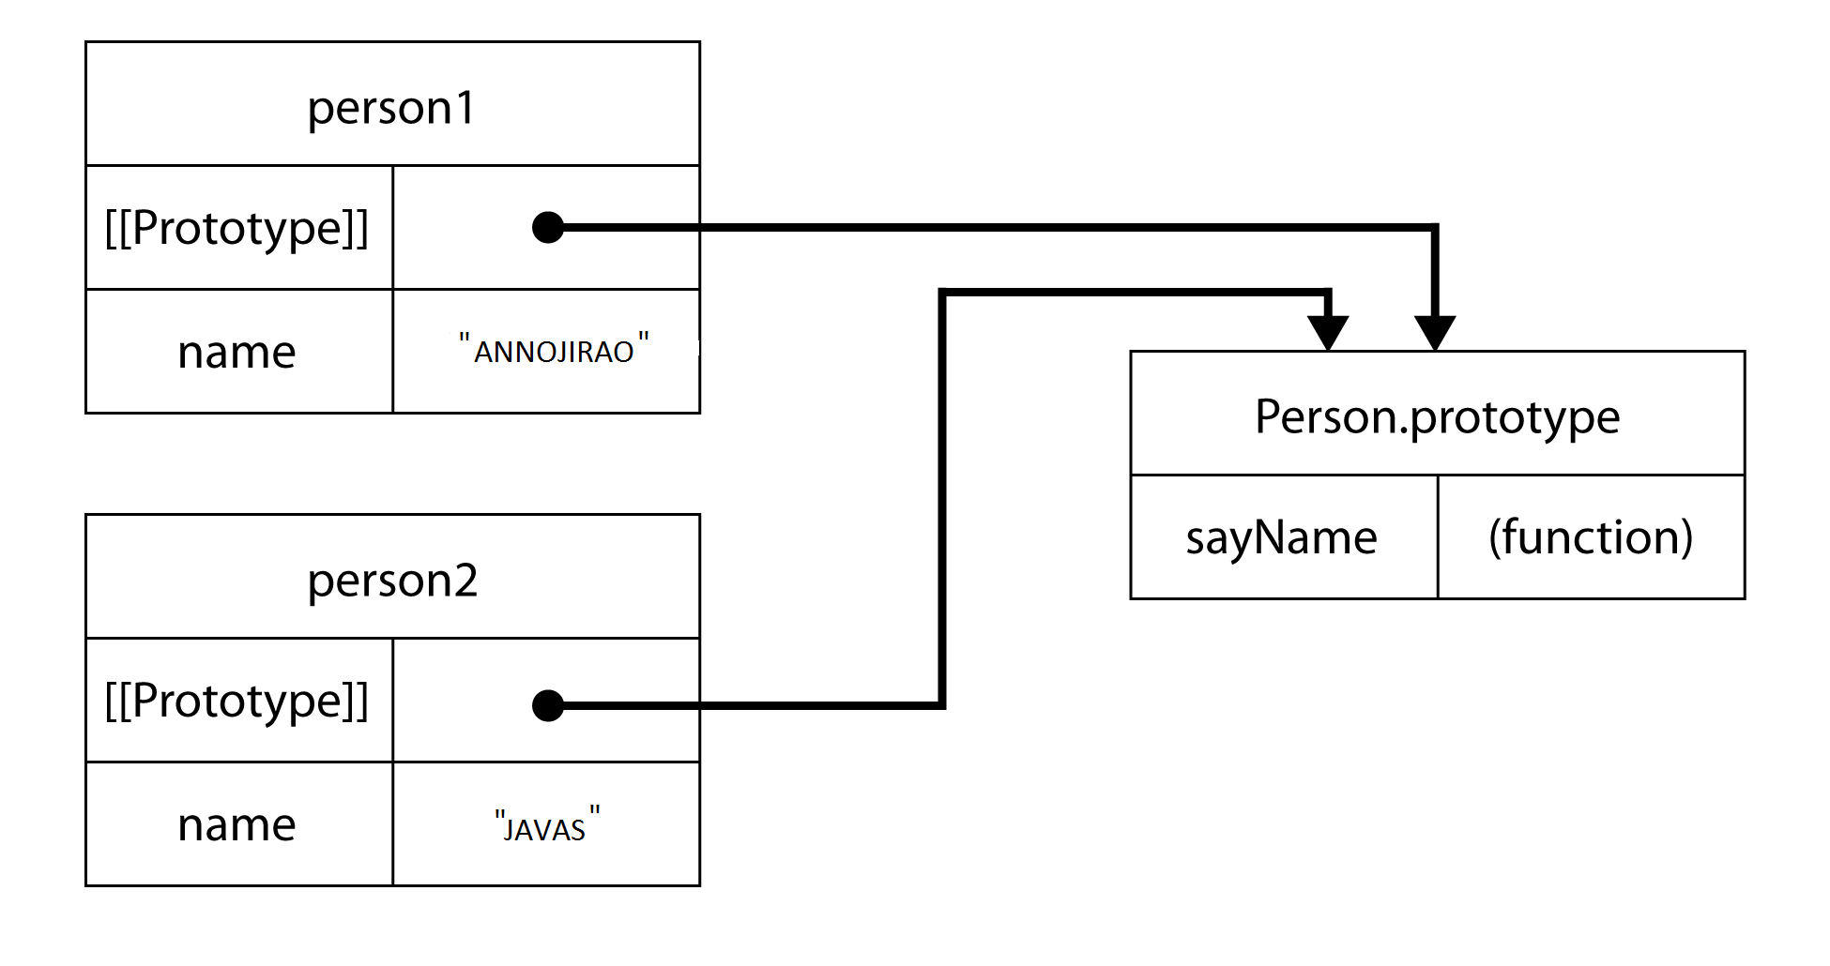
prototype -- continued
Notes:
function Person(argument){
this.name = argument;
this.sayName = function(){
console.log(this.name)
}
}
var person1 = new Person("ANNOJIRAO");
var person2 = new Person(“JAVAS") ;
var book = {
title: "The Principles of Object-Oriented JavaScript"
};
console.log("title" in book); // true
console.log(book.hasOwnProperty("title")); // true
console.log("hasOwnProperty" in book); // true
console.log(book.hasOwnProperty("hasOwnProperty")); // false
console.log(Object.prototype.hasOwnProperty("hasOwnProperty")); // true

Slide 21
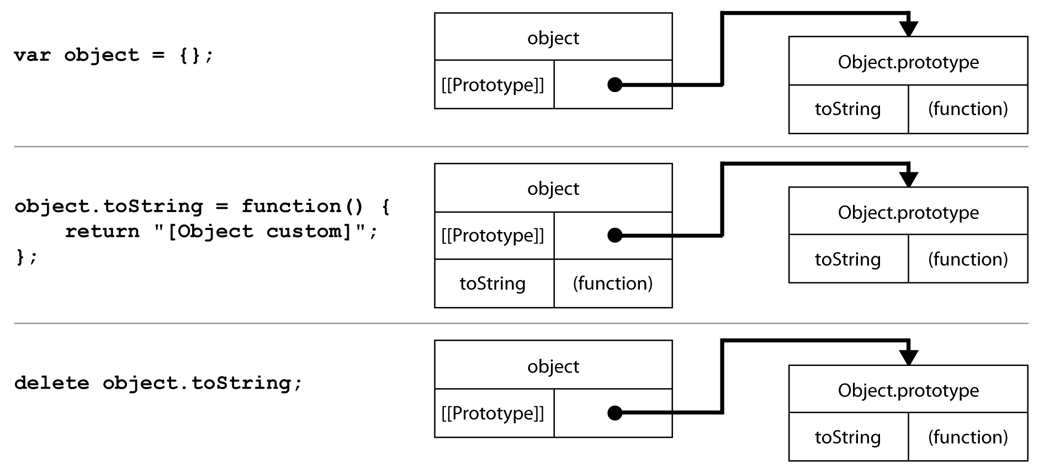
prototype -- continued
Notes:
var object = {};
console.log(object.toString()); // "[object Object]"
object.toString = function() {
return "[object Custom]";
};
console.log(object.toString()); // "[object Custom] "
delete object.toString;
console.log(object.toString()); // "[object Object]"
// no effect - delete only works on own properties
delete object.toString;
console.log(object.toString()); // "[object Object]"

Slide 22
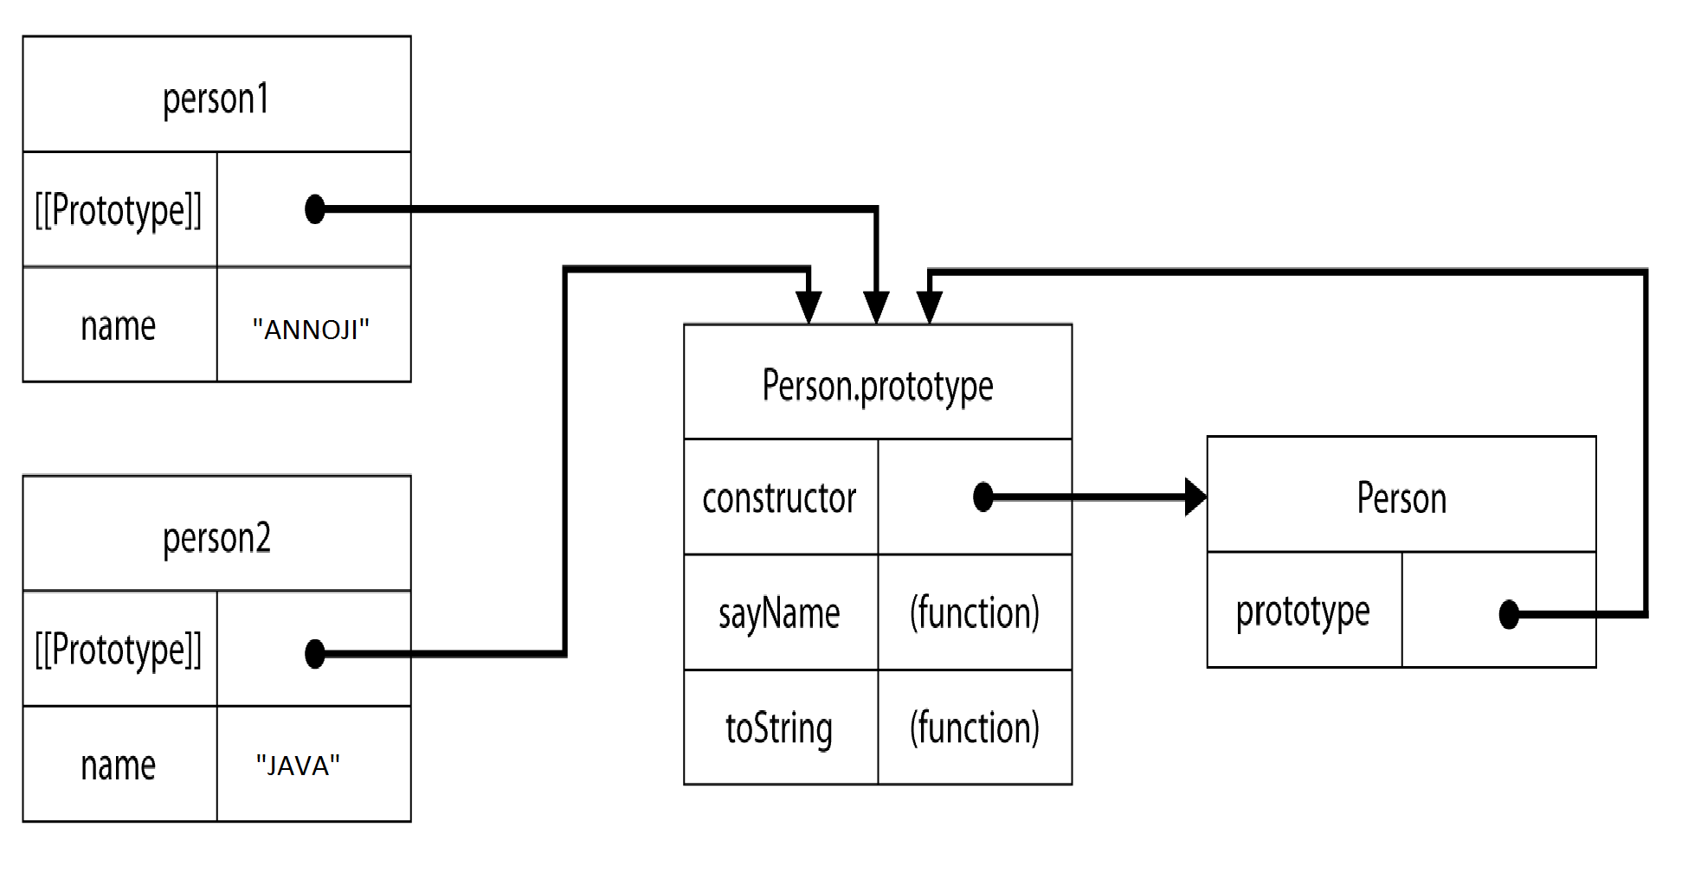
prototype -- continued
Notes:
function Person(name) {
this.name = name;
}
Person.prototype.sayName = function() {
console.log(this.name);
};
Person.prototype.favorites = [];
var person1 = new Person(“Annoji");
var person2 = new Person(“Rao");
person1.favorites.push("pizza");
person2.favorites.push(“sandwich");
console.log(person1.favorites); // "pizza,sandwich"
console.log(person2.favorites); // "pizza,sandwich“
function Person(name) {
this.name = name;
}
Person.prototype = {
sayName: function() {
console.log(this.name);
},
toString: function() {
return "[Person " + this.name + "]";
}
};
var person1 = new Person(“Annojirao");
console.log(person1 instanceof Person); // true
console.log(person1.constructor === Person); // false
console.log(person1.constructor === Object); // true
// reinitialising the constructor property of prototype in object literal initiliaisation
Person.prototype = {
constructor: Person,
sayName: function() {
console.log(this.name);
},
toString: function() {
return "[Person " + this.name + "]";
}
};
var person1 = new Person(“Annoji");
var person2 = new Person(“rao");
console.log(person1 instanceof Person); // true
console.log(person1.constructor === Person); // true
console.log(person1.constructor === Object); // false
console.log(person2 instanceof Person); // true
console.log(person2.constructor === Person); // true
console.log(person2.constructor === Object); // false
Freeze will freeze at object level but not at prototype level
var person1 = new Person(“Annojirao");
var person2 = new Person(“Rao");
Object.freeze(person1);
Person.prototype.sayHello= function() {
console.log("Hello");
};
person1.sayHello(); // outputs "Hello"
person2.sayHello(); // outputs "Hello"

Slide 23
Usage of prototype
1 . Array.prototype.sum = function(){
return this.reduce(function(previous,current){
return previous+current;
})
}
[1,2,4].sum() // 7
2. String.prototype.capitalize = function() {
return this.charAt(0).toUpperCase() + this.substring(1);
};
var message = "hello welcome!";
console.log(message.capitalize()); // "Hello welcome!“
3. String.prototype.Replace = function(){
return this.replace(/\s/g,"_")
}
var welcomeMsg = "hello welcome to india“
welcomeMsg.Replace() // "hello_welcome_to_india"

Slide 24
Prototypal Inheritance
Class-free
[[prototype]] inherit from prototype
An object contains a secret link to its constructor’s prototype
ECMA defines it as __proto__
Child.prototype = Object.create(Parent.prototype);
Notes:
function Parent (argument) {
if(!(this instanceof Parent)){
return new Parent();
}
this.firstName = argument || 'god';
this.getName = function (argument) {
// body...
console.log("name inside constructor is "+this.firstName);
}
// body...
}
Parent.prototype.getName = function(first_argument) {
// body...
console.log('name is '+this.firstName);
};
function Child (argument) {
// body...
//Parent.call(this,'javascript');
}
var parentInstance = new Parent('ECMAScript');
parentInstance.getName();
Child.prototype = Object.create(Parent.prototype);
var inhritedChild = new Child();
inhritedChild.getName();

Slide 25
Prototypal Inheritance -- continued
Changes in Parent may be immediately visible in Child.
Changes to Child have no effect on Parent.
Parent can be the prototype for an unlimited number of objects which will inherit all its properties
Child
Parent

Slide 26
Prototypal Inheritance -- continued
If access to a member of Child fails, then search for the member in Parent.
If that fails, then search for the member in Object.prototype
Child.prototype
Parent.prototype
Object.prototype
…….

Slide 27
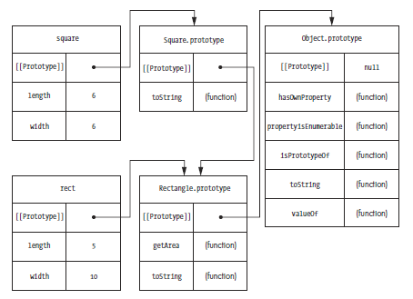
prototypal chaining
Notes:
function Rectangle(length, width) {
this.length = length;
this.width = width;
}
Rectangle.prototype.getArea = function() {
return this.length * this.width;
};
Rectangle.prototype.toString = function() {
return "[Rectangle " + this.length + "x" + this.width + "]";
};
// inherits from Rectangle
function Square(size) {
this.length = size;
this.width = size;
}
Square.prototype = new Rectangle();
Square.prototype.constructor = Square;
Square.prototype.toString = function() {
return "[Square " + this.length + "x" + this.width + "]";
};
var rect = new Rectangle(5, 10);
var square = new Square(6);
console.log(rect.getArea()); // 50
console.log(square.getArea()); // 36
console.log(rect.toString()); // "[Rectangle 5x10]"
console.log(square.toString()); // "[Square 6x6]"
console.log(rect instanceof Rectangle); // true
console.log(rect instanceof Object); // true
console.log(square instanceof Square); // true
console.log(square instanceof Rectangle); // true
console.log(square instanceof Object); // true

